Slide 1
Principles of Data Communications
(ICT 2156)

Slide 2
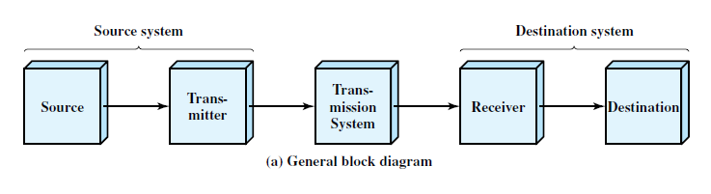
Concepts and Terminology
Communication mode : simplex, half-duplex, full-duplex
.

Slide 3
Analog and Digital Data
An entity that conveys some meaning based on some mutually agreed up conventions between a sender and a receiver.
1000001
Analog data have continuous values over a time.
Digital data takes discrete value.
.

Slide 4
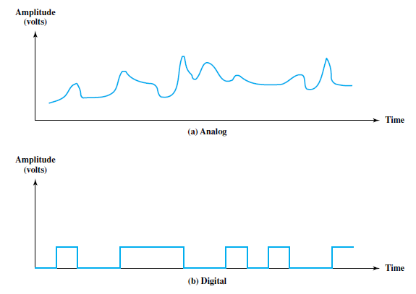
Analog and Digital Signals
Signal : is a electric, electromagnetic or optical representation of data which can be sent over a communication media.
Analog signal : signal intensity varies in a smooth fashion over time.
Digital signal : signal intensity maintains a constant level for some period of time and then abruptly changes to another constant level.
.

Slide 5
Periodic and Nonperiodic Signals
A periodic signal completes a pattern within a measurable time frame, called a period, and repeats that pattern over subsequent identical periods.
The completion of one full pattern is called a cycle.
A nonperiodic signal changes without exhibiting a pattern that repeats over time.
Both analog and digital signals can be periodic or nonperiodic.
.

Slide 6
PERIODIC ANALOG SIGNALS
Periodic analog signals can be classified as simple or composite.
A simple periodic analog signal, a sine wave, cannot be decomposed into simpler signals.
A composite periodic analog signal is composed of multiple sine waves.
.

Slide 7
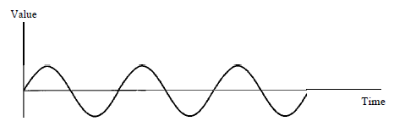
PERIODIC ANALOG SIGNALS
Sine Wave
fundamental form of a periodic analog signal.
Characterized by three parameters: peak amplitude, frequency, and phase.
Figure 3.2 A sine wave
.

Slide 8
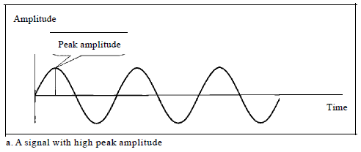
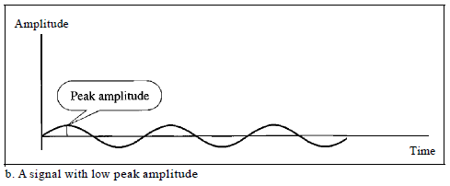
Sine Wave : Peak Amplitude
The peak amplitude of a signal is the absolute value of its highest intensity, proportional to the energy it carries.
signals with the same phase and frequency, but different amplitudes
.

Slide 9

Sine Wave : Period and Frequency
Period refers to the amount of time ( in seconds ) a signal needs to complete 1 cycle.
Frequency refers to the number of periods in I s.
.

Slide 10
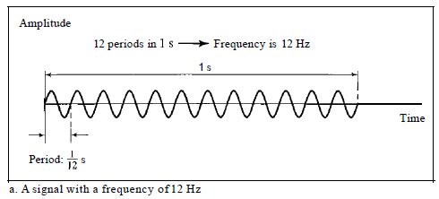
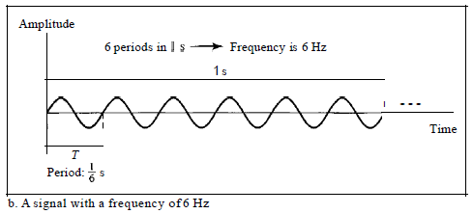
Sine Wave : Period and Frequency
Two signals with the same amplitude and phase, but different frequencies
.

Slide 11
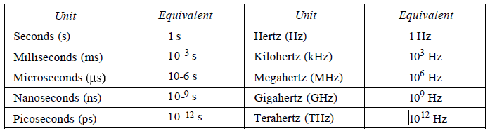
Sine Wave : Period and Frequency
Period is formally expressed in seconds.
Frequency is formally expressed in Hertz (Hz), which is cycle per second.
Table 3.1 Units of period and frequency
.

Slide 12

Sine Wave : Period and Frequency
The power we use at home has a frequency of 60 Hz.
The period of this sine wave is:
Period of the power for our lights at home is 0.0116 s, or 16.6 ms.
Our eyes are not sensitive enough to distinguish these rapid changes in amplitude.
.

Slide 13
Sine Wave : Period and Frequency
Frequency is the rate of change with respect to time.
Change in a short span of time means high frequency.
Change over a long span of time means low frequency.
.

Slide 14
Sine Wave : Phase
phase describes the position of the waveform relative to time O.
It indicates the status of the first cycle.
Phase is measured in degrees or radians.
A phase shift of 360° corresponds to a shift of a complete period;
a phase shift of 180° corresponds to a shift of one-half of a period;
and a phase shift of 90° corresponds to a shift of one-quarter of a period.
.

Slide 15
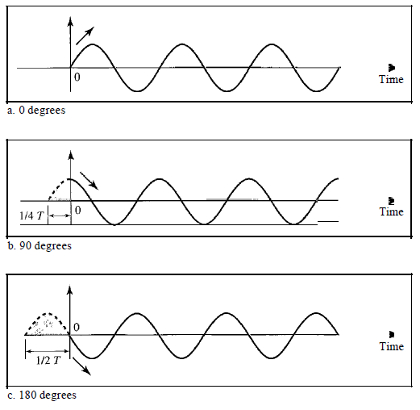
Sine Wave : Phase
Three sine waves with the same amplitude and frequency, but different phases
.

Slide 16
Sine Wave : Phase
A sine wave with a phase of 0° is not shifted.
A sine wave with a phase of 90° is shifted to the left by 1/4 cycle.
A sine wave with a phase of 180° is shifted to the left by 1/2 cycle
.

Slide 17
Sine Wave : Phase
A sine wave is offset 1/6 cycle with respect to time O. What is its phase in degrees and radians?
Solution
1 complete cycle is 360°. Therefore, 1/6 cycle is
1/6 * 360 = 60
.

Slide 18
wavelength
Distance occupied in space by a single period.
Wavelength = propagation speed / frequency.
Example : wavelength of redlight (frequency = 4*10¹⁴ Hz) is
c/f = 3*10⁸m/s /4*10¹⁴
^{= 0.75 micro meter}
.

Slide 19
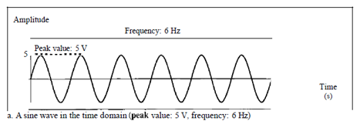
Time and Frequency Domains
The time-domain plot shows changes in signal amplitude with respect to time.
It is an amplitude-versus-time plot.
.

Slide 20
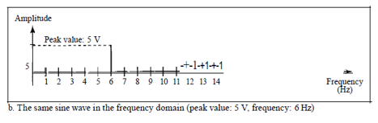
Time and Frequency Domains
.

Slide 21
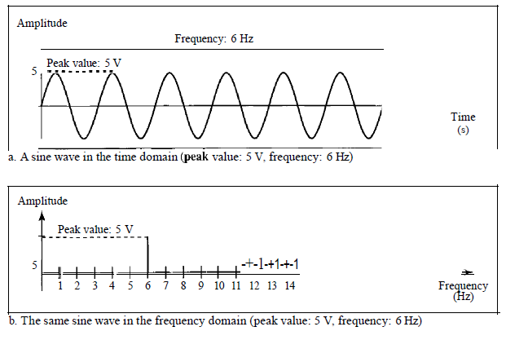
Time and Frequency Domains
The time-domain and frequency-domain plots of a sine wave
.

Slide 22
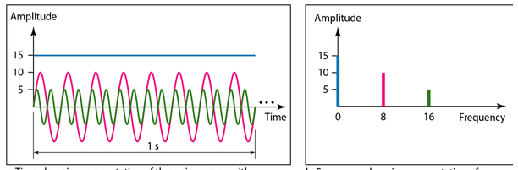
Time and Frequency Domains
Figure shows 3 sine waves, each with different amplitude and frequency.
All can be represented by three spikes in the frequency domain..
The time domain and frequency domain of three sine waves
.

Slide 23
Composite Signals
A single a frequency sine wave is not useful in data communications;
We need to send a composite signal to communicate data.
A composite signal is made of many simple sine waves.
.

Slide 24
Composite Signals
In the early 1900s, the French mathematician Jean-Baptiste Fourier showed that any composite signal is actually a combination of simple sine waves with different frequencies, amplitudes, and phases.
.

Slide 25
Composite Signals
A composite signal can be periodic or nonperiodic.
A periodic composite signal can be decomposed into a series of simple sine waves with discrete frequencies that have integer values (1, 2, 3, and so on).
A nonperiodic composite signal can be decomposed into a combination of an infinite number of simple sine waves with continuous frequencies, frequencies that have real values.
.

Slide 26
Composite Signals
If the composite signal is periodic, the decomposition gives a series of signals with discrete frequencies;
if the composite signal is nonperiodic, the decomposition gives a combination of sine waves with continuous frequencies.
.

Slide 27
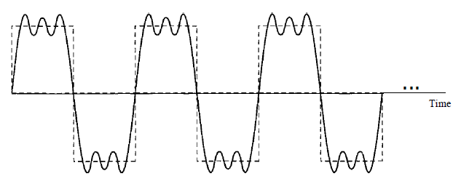
Composite Signals
Figure shows a periodic composite signal with frequency f.
This type of signal is not typical of those found in data communications.
A composite periodic signal
.

Slide 28
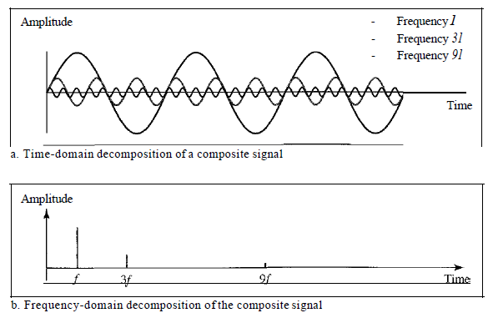
Composite Signals
It is difficult to manually decompose signal into a series of simple sine waves.
There are tools, both hardware and software, that can help us do the job.
Decomposition of a composite periodic signal in the time and frequency domains
.

Slide 29
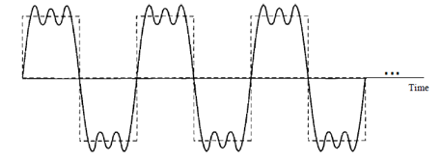
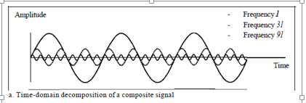
Composite Signals
The amplitude of the sine wave with frequency f is almost the same as the peak amplitude of the composite signal.
The amplitude of the sine wave with frequency 3f is one-third of that of the first, and the amplitude of the sine wave with frequency 9f is one-ninth of the first.
.

Slide 30
Composite Signals
The frequency of the sine wave with frequency f is the same as the frequency of the composite signal; it is called the fundamental frequency, or first harmonic.
The sine wave with frequency 3f has a frequency of 3 times the fundamental frequency; it is called the third harmonic.
The third sine wave with frequency 9fhas a frequency of 9 times the fundamental frequency; it is called the ninth harmonic.
.

Slide 31

Periodic analog signal
where T is the period of the signal.
.

Slide 32
Periodic analog signal
Periodic analog signal characterized by 3 parameters.
Representation of sine wave
s (t) = A sin (2πft + φ)
Where A is peak amplitude.
.

Slide 33
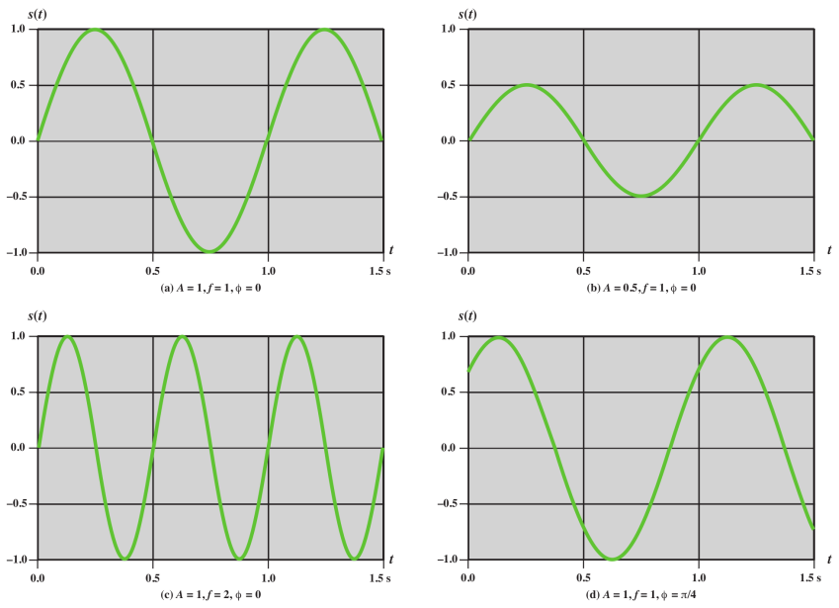
.

Slide 34
UNITS of Parameter
Amplitude : volts, milli (10⁻³) volt, KV(10³)
Frequency : Hz, KHz(10³), MHz(10⁶), GHz(10⁹), THz(10¹²)
Time : second, milli second(10⁻³), micro second(10⁻⁶), ns(10⁻⁹), ps(10⁻¹²)
Phase : degree , radian
.

Slide 35
Composite signals can be expressed as a combination of simple sine waves with different amplitude, frequency and phase.
s (t ) = A₁ sin (2πf₁t + φ₁) + A₂ sin (2πf₂t + φ₂) + A₃ sin (2πf₃t + φ₃) +……..
.

Slide 36
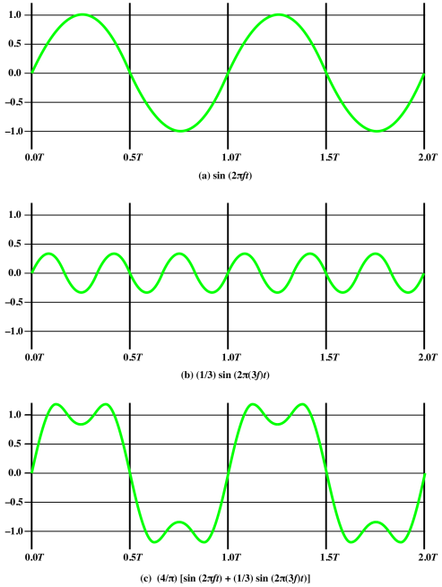
s (t ) = A₁ sin (2πf₁t + φ₁) + A₂ sin (2πf₂t + φ₂) +……..
.

Slide 37
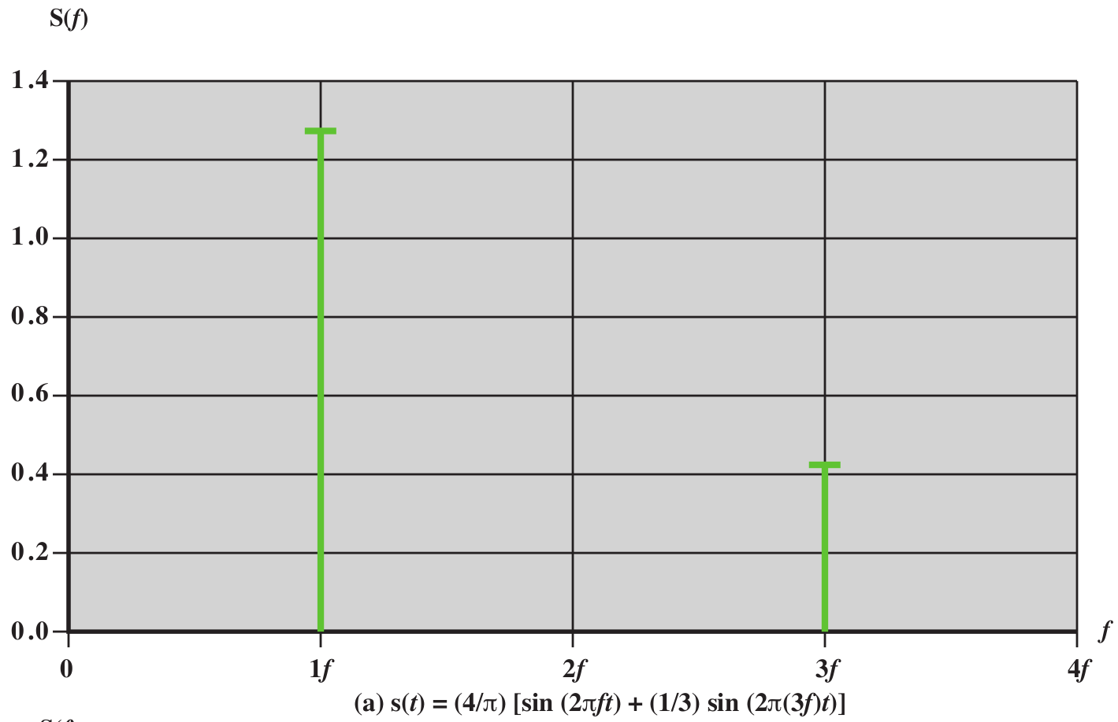
.

Slide 38
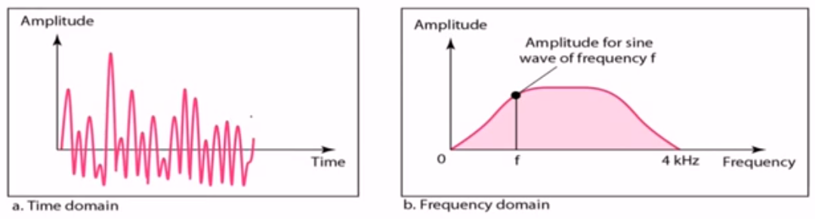
Composite Signals
Figure shows a nonperiodic composite signal.
signal created by a microphone or a telephone.
There are an infinite number of simple sine frequencies.
Although the number of frequencies in a human voice is infinite, range is limited.
Range of frequencies between 0 and 4 kHz.
.

Slide 39
Frequency Domain Concepts
The spectrum of a signal is the range of frequencies that it contains.
The absolute bandwidth of a signal is the width of the spectrum.
Many signals have an infinite bandwidth.
Most of the energy in the signal is contained in a relatively narrow band of frequencies.
This band is referred to as the effective bandwidth, or just bandwidth.
.

Slide 40
Bandwidth
The bandwidth of a composite signal is the difference between the highest and the lowest frequencies contained in that signal.
If a composite signal contains frequencies between 1000 and 5000, its bandwidth is 5000 - 1000, or 4000.
.

Slide 41
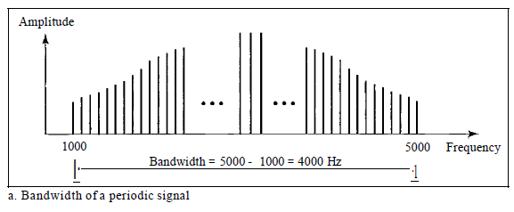
Bandwidth
The figure depicts periodic composite signals.
The bandwidth of the periodic signal contains all integer frequencies between 1000 and 5000 (1000, 100 I, 1002, ...).
Figure 3.12 The bandwidth of periodic composite signals
.

Slide 42
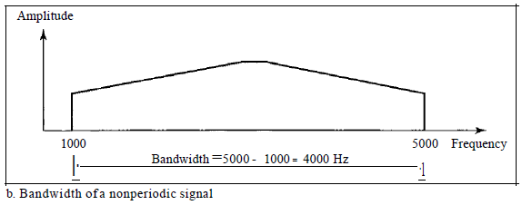
Bandwidth
Below nonperiodic composite signals.
The bandwidth of the nonperiodic signals has the same range, but the frequencies are continuous.
The bandwidth of nonperiodic composite signals
.

Slide 43
Bandwidth
If a periodic signal is decomposed into five sine waves with frequencies of 100, 300, 500, 700, and 900 Hz, what is its bandwidth?
Draw the spectrum, assuming all components have a maximum amplitude of 10 V.
.

Slide 44
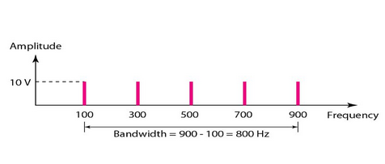
Bandwidth
If a periodic signal is decomposed into five sine waves with frequencies of 100, 300, 500, 700, and 900 Hz, what is its bandwidth?
Draw the spectrum, assuming all components have a maximum amplitude of 10 V.
Solution
Then B =f_{h} - i_{t} = 900 - 100 =800 Hz
.

Slide 45
Bandwidth
A nonperiodic composite signal has a bandwidth of 200 kHz, with a middle frequency of140 kHz and peak amplitude of 20 V.
The two extreme frequencies have an amplitude of 0.
Draw the frequency domain of the signal..
.

Slide 46
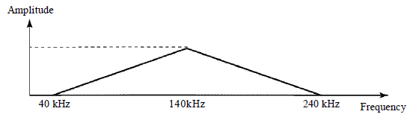
Bandwidth
A nonperiodic composite signal has a bandwidth of 200 kHz, with a middle frequency of140 kHz and peak amplitude of 20 V.
The two extreme frequencies have an amplitude of 0.
Draw the frequency domain of the signal..
Solution
.

Slide 47
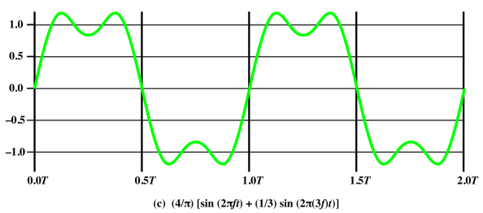
.

Slide 48
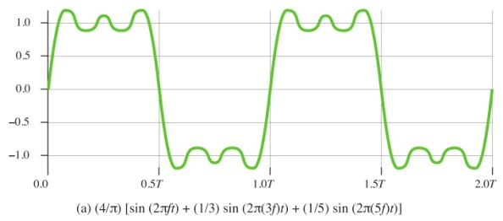
.

Slide 49
.

Slide 50
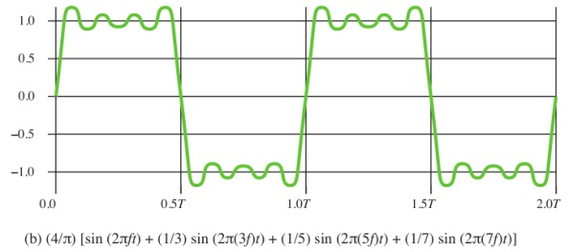
.

Slide 51
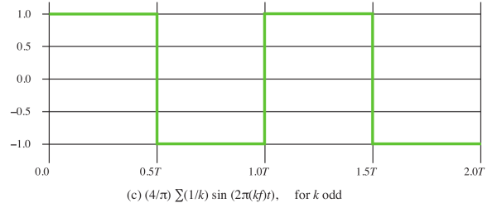
.

Slide 52

The frequency components of the square wave with amplitudes A and can be expressed as follows:
.

Slide 53
Digital signal
Based on Fourier analysis, a digital signal is a composite analog signal.
A digital signal can be considered as a signal with an infinite number of frequencies.
.

Slide 54

DIGITAL SIGNALS
Digital Signal as a Composite Analog Signal
Fourier analysis can be used to decompose a digital signal.
If the digital signal is periodic, (rare in data communications ), the decomposed signal has a frequency domain representation with an infinite bandwidth and discrete frequencies.
If the digital signal is nonperiodic, the decomposed signal still has an infinite bandwidth, but the frequencies are continuous.
.

Slide 55
Digital signal
Most digital signals are nonperiodic
period and frequency are not appropriate characteristics.
Bit interval
Time required to send a single bit.
.

Slide 56
Digital signal
Bit Rate
Number of bits sent in 1 second, expressed in bits per second (bps).
Number of bit intervals per second.
.

Slide 57

Digital signal
A digital signal can have more than two levels.
In this case, we can send more than 1 bit for each level.
.

Slide 58
DIGITAL SIGNALS
We send 1 bit per level in part a and 2 bits per level in part b of the figure.
In general, if a signal has L levels, each level needs log ₂L bits.
.

Slide 59
DIGITAL SIGNALS
A digital signal has eight levels. How many bits are needed per level?
Number of bits per level =log₂ 8 =3
Each signal level is represented by 3 bits.
.

Slide 60
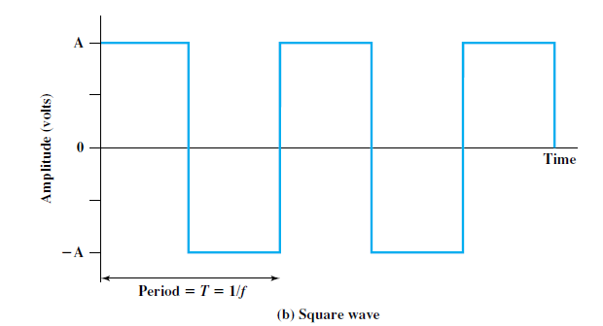
Relationship between Data Rate and Bandwidth
consider the square wave.
let positive pulse represent binary 0 negative pulse represent binary 1.
Then the waveform represents the binary stream 0101. . . .
The duration of each pulse is T/2 = 1/(2f )
thus the data rate is 2f bits per second (bps).
.

Slide 61
Relationship between Data Rate and Bandwidth
Waveform has an infinite number of frequency components and hence an infinite bandwidth.
What happens if we limit the bandwidth to just the first three frequency components?
Suppose a digital transmission system is capable of transmitting signals with a bandwidth of 4 MHz.
What data rate can be achieved? We look at 3 cases.
.

Slide 62
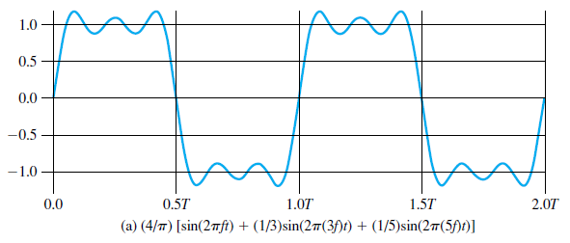
Relationship between Data Rate and Bandwidth
Case I.
5f – f = 4MHz
f = 1 MHz
T = 1/f = 1/1MHz =
f 5f
In we can second 2bits
bandwidth
So in 1 second we can send 2Mbps
.

Slide 63
Relationship between Data Rate and Bandwidth
Case 2
5f – f = 8MHz
f = 2 MHz
T = 1/f = 1/2MHz =
f 5f
In we can second 2bits
bandwidth
So in 1 second we can send 4Mbps
.

Slide 64
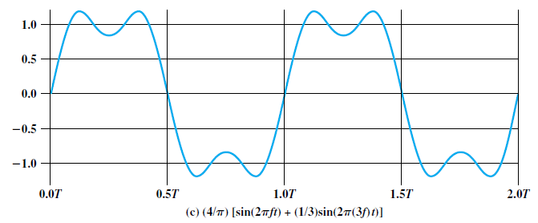
Relationship between Data Rate and Bandwidth
Case 3
3f – f = 4MHz
f = 2 MHz
T = 1/f = 1/2MHz =
f 3f
In we can second 2bits
bandwidth
So in 1 second we can send 4Mbps
.

